Slide 1

Team 6
The Crazy Puzzle Team

Slide 2

Team Members
Brent Dombrowski
Hema Kumar
Derek Qian
Frank Sliz

Slide 3
Status Of Project Development
Equation Slider Crazy Game
      Scramble / Unscramble tiles
      Background of the game
      Equation Selection
      Scoring
      No Repetition of Equations being allowed
Number Slider Crazy Game
      Working with the option to select grid size
      State of the game is saved
      Based on Number of moves
      Background image of the game

Slide 4
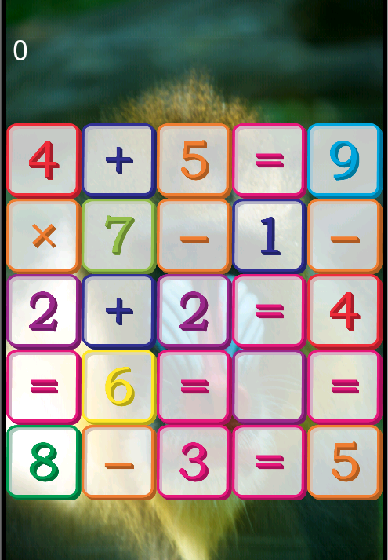
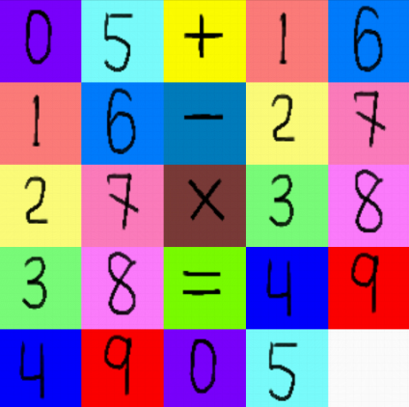
Change in User Interface

Slide 5
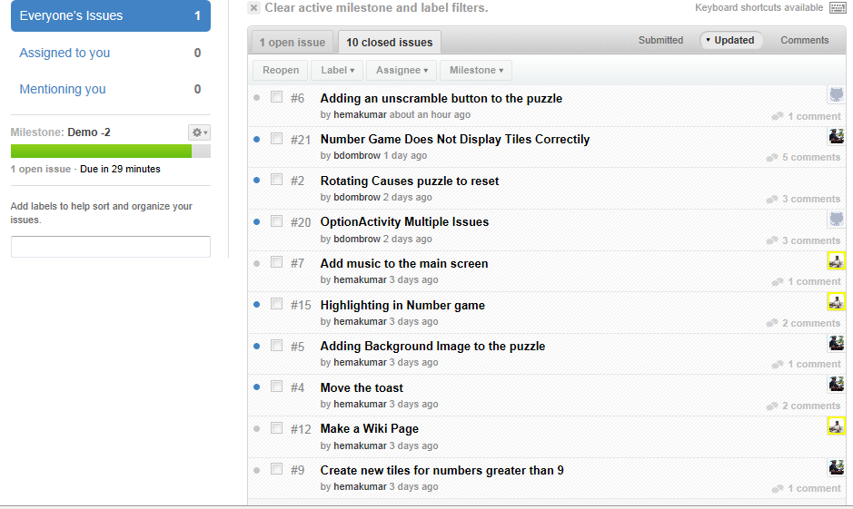

Improvements in the process
Issue Tracker

Slide 6
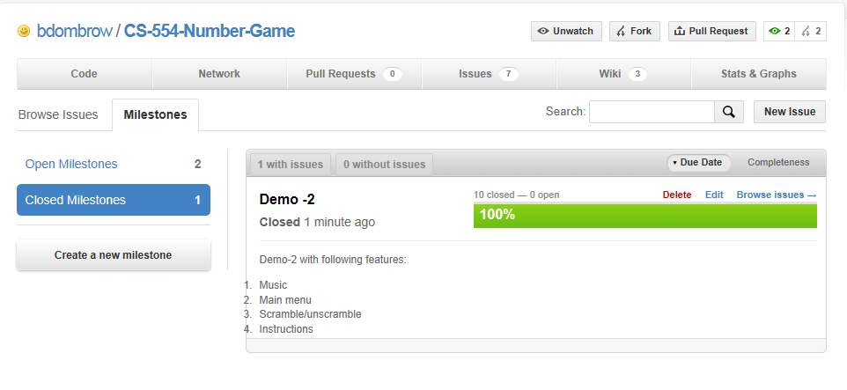
Improvements in the process- Milestones

Slide 7
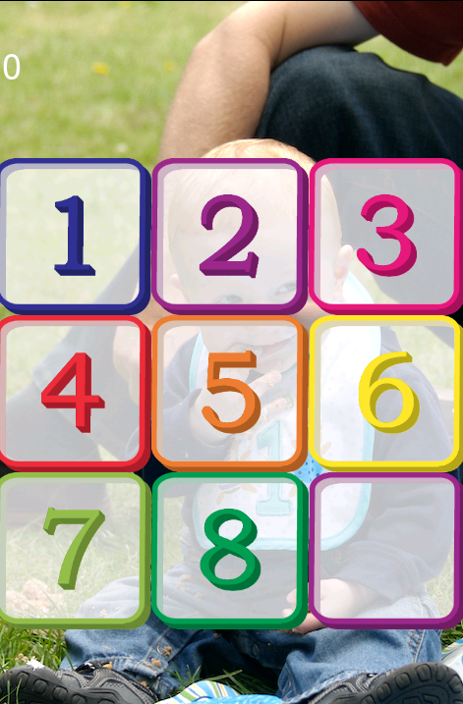
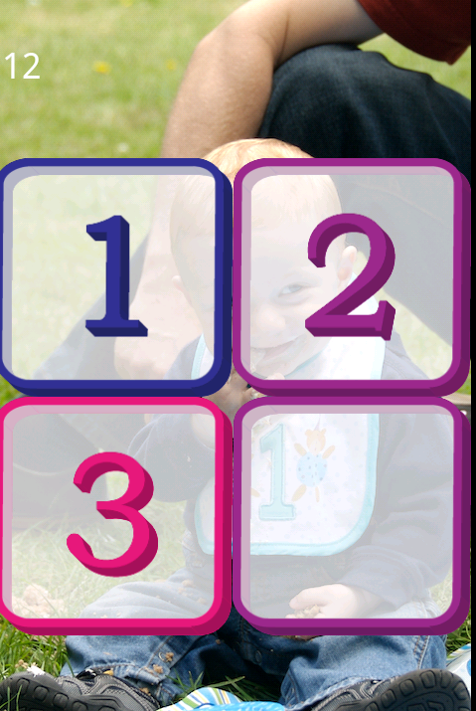
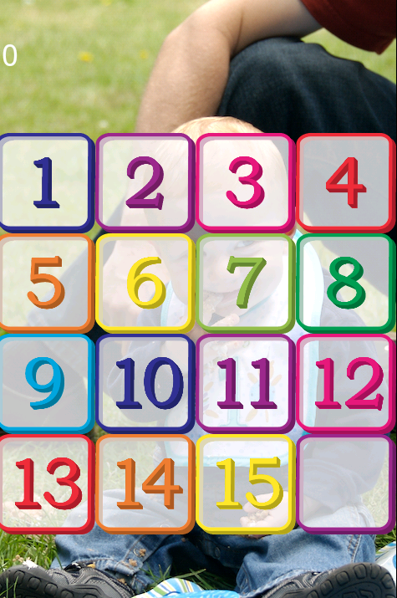
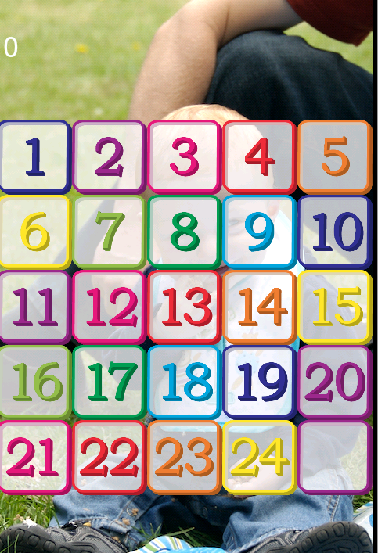
Number Game

Slide 8
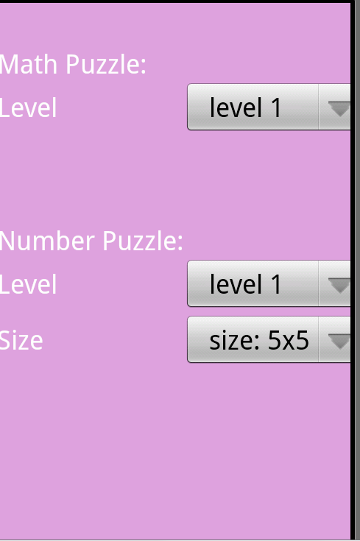
Options menu

Slide 9
Expectations Met
Add tile scrambling and unscrambling
Add dragging gesture for equation selection
Add equation validation and scoring
Add difficulty selection
Start development of puzzle in mode 2

Slide 10
Features for next Sprint
Scramble for Number Puzzle
Artificial Intelligence
Option to select different song
Option to select level of difficulty

